Slide 1




DevOps Intelligence Platform
Deliver Better Software Faster!
IDC Innovators 2016
12 Cloud Computing Companies to Watch
5 Startups redefining DevOps

Slide 2




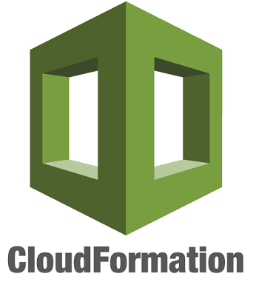


















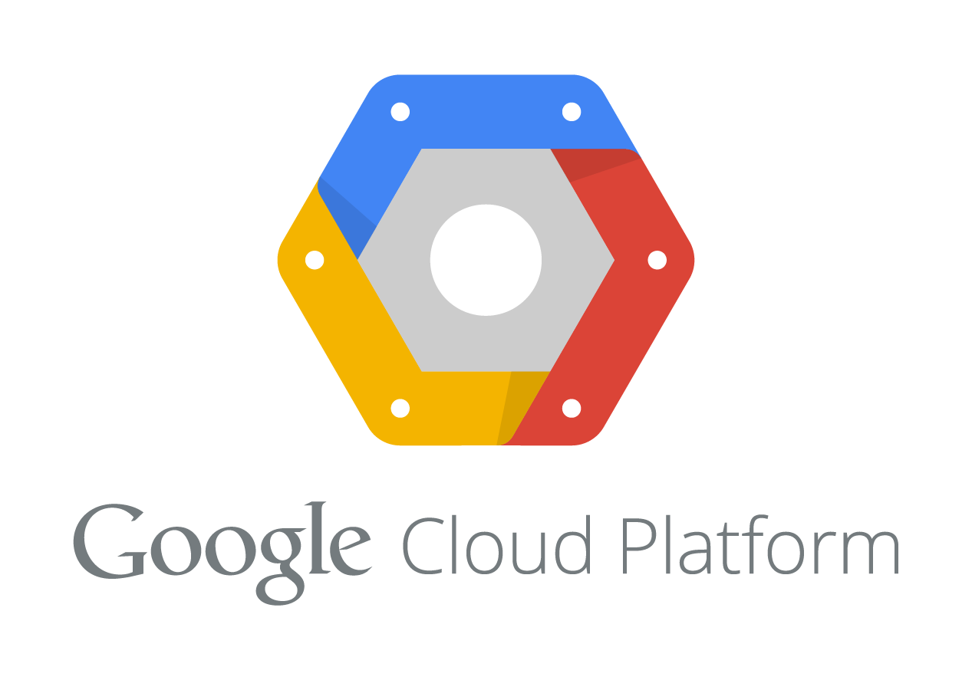
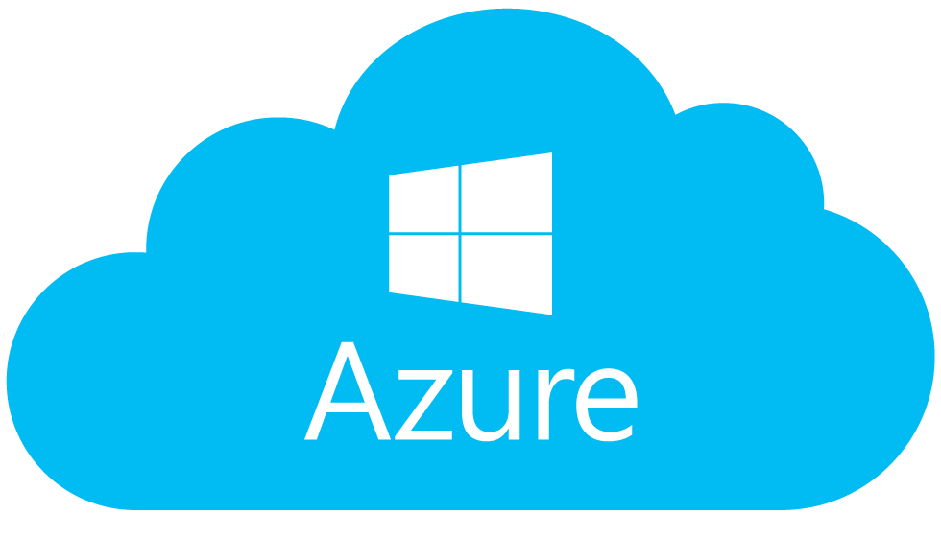






DevOps Intelligence Platform
Analytics
Actions
Dashboards
Alerts & Notifications
Recommendations
Automation
Tasks
API, CLI & SDK

